Slide 1


Slide 2
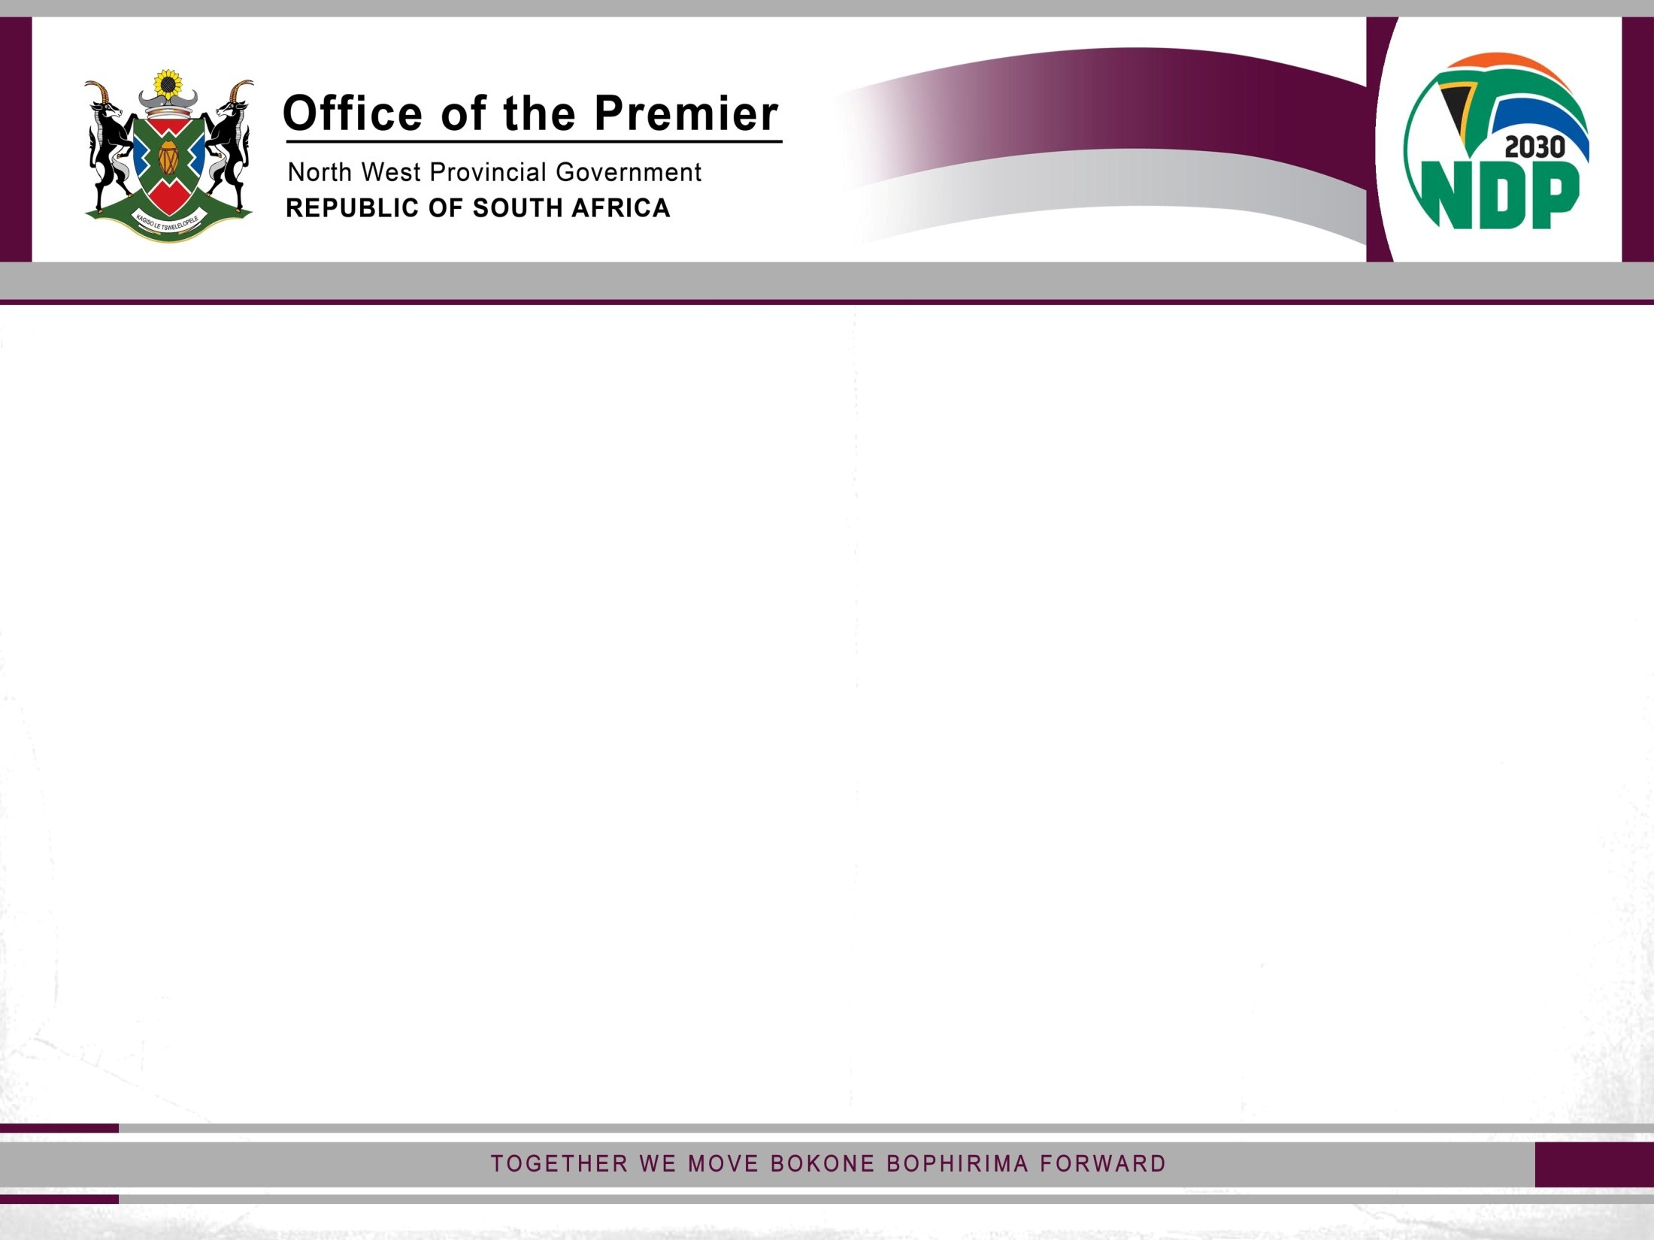
Calendar of events 2017
(Department of Tourism)

Slide 3
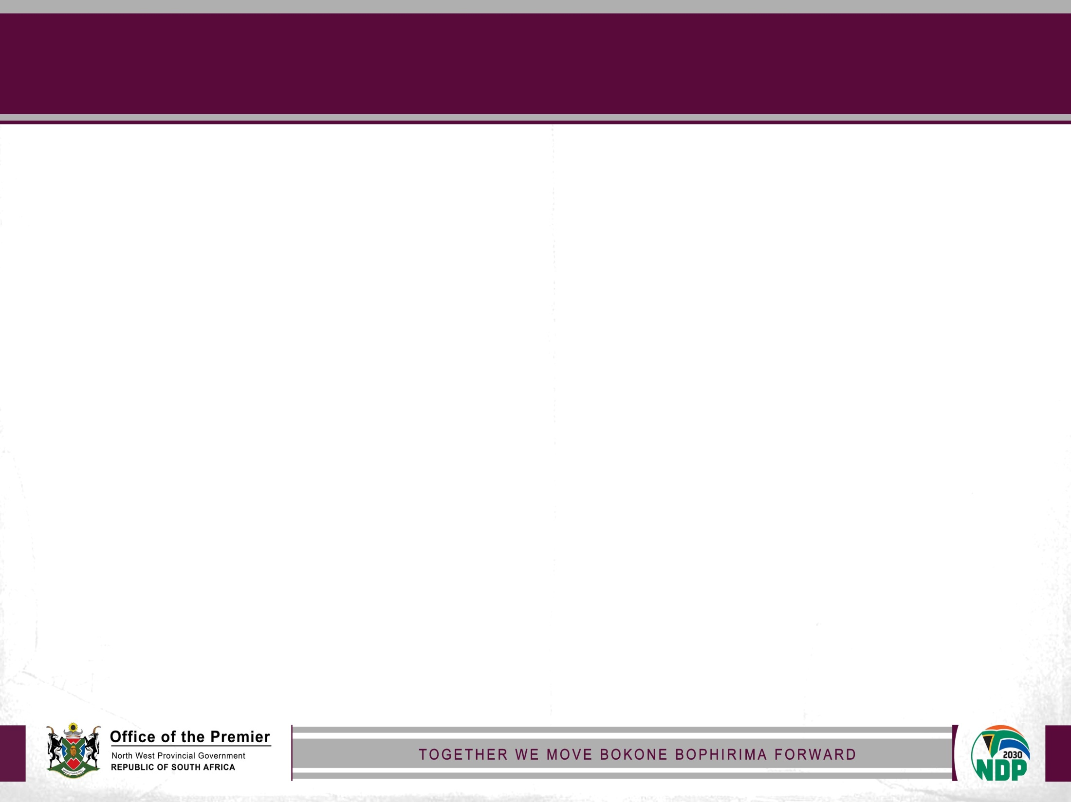
Calendar of events (August 2017)
Date | Event | Venue | Contact person | Telephone number
24 August 2017 | Bojanala District Tourism Lekgotla | Madibeng Town Hall | Mr. B. Jonkers | 018 387 7880
24 August 2017 | Women in Tourism Breakfast Launch | Hartebeespoortdam | Ms. S . Manone | 018 387 7912
29 August 2017 | Dr. Kenneth Kaunda District Tourism Lekgotla | Matlosana Recreational Centre Hall | Mr. B. Jonkers | 018 387 7880
29-30 August 2017 | Departmental Women’s Day Celebration | Klerksdorp | Ms. T. Ramakaba | 018 388 4817/2368

Slide 4
Calendar of events (September 2017)
Date | Event | Venue | Contact person | Telephone number
01 September 2017 | Provincial Tourism Month Launch and Media tour | Bojanala | Ms. S . Manone | 018 387 7912
11 September 2017 | Responsible and Sustainable Tourism Workshop | Rustenburg | Ms. S. Manone | 018 387 7912
12 September2017 | Service Excellence Workshop and Blitz | Rustenburg | Ms. S . Manone | 018 387 7912
14-16 September 2017 | Botswana Marketing Campaign | Botswana | Ms. S . Manone | 018 387 7912
18 September 2017 | Basic Business Management Training | Mmabatho | Ms. S . Manone | 018 387 7912
20 September 2017 | Service Excellence Workshop and Blitz | Vryburg | Ms. S . Manone | 018 387 7912

Slide 5
Calendar of events (August 2017)
Date | Event | Venue | Contact person | Telephone number
22 September 2017 | Service Excellence Workshop and Blitz | Taung | Ms. S . Manone | 018 387 7912
23-25 September 2017 | Getaway Show | Gauteng | Ms. S . Manone | 018 387 7912
26 September 2017 | Business Management Training | Vryburg | Ms. S . Manone | 018 387 7912
27 September 2017 | World Tourism Day Celebration | Mpumalanga | Ms. S . Manone | 018 387 7912
29-30 September 2017 | National Tourism Career Expo | Mpumalanga | Ms. S. Manone | 018 387 7912
30 September 2017 | SATMA awards | Sun City | Ms. S . Manone | 018 387 7912

